Slide 1

CHEEPAA
PORTABLE AIR QUALITY MONITOR
for Respiratory Health

Slide 2
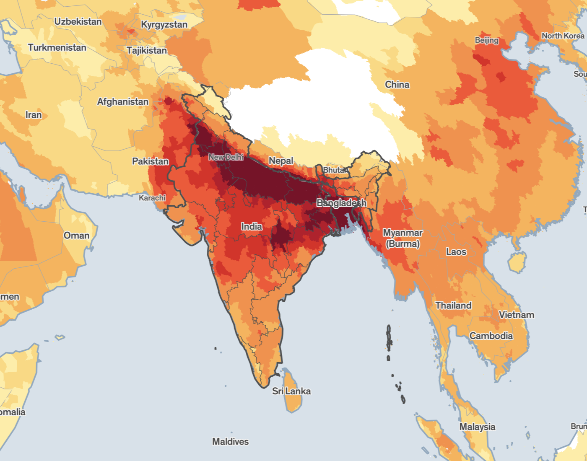
Cheepaa
THE PROBLEM:
Problem: Individuals with respiratory conditions like asthma and COPD are highly sensitive to poor air quality, leading to health issues.
Impact: Poor air quality can trigger severe symptoms and reduce the quality of life for these individuals.
Current Challenge: Existing air quality monitoring systems are not portable, personalized, or user-friendly for daily use.

Slide 3
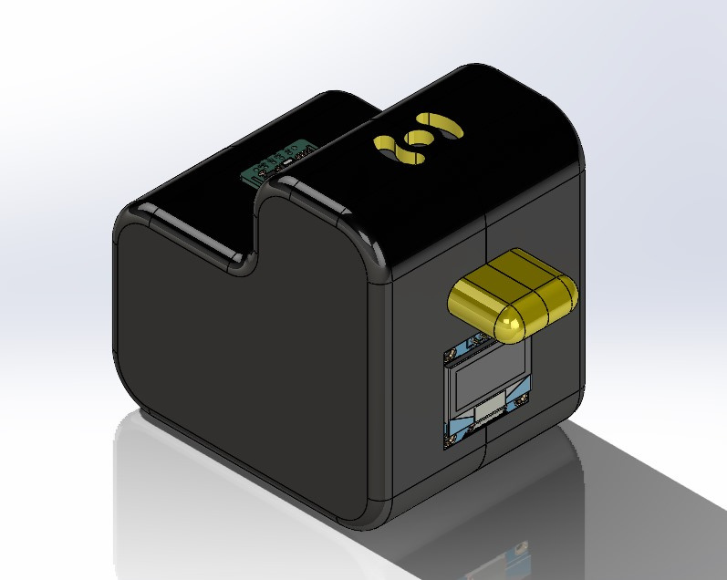
Cheepaa
OUR SOLUTION
Solution: A portable, bird-shaped air quality monitor named "Cheepa" that provides real-time air quality feedback, alerts, and data logging.
Key Features:
-Real-Time Feedback through audible chirps
-Mobile Connectivity (Wifi-enabled)
-Health Alerts with custom notifications
-Rechargeable & Long-Lasting battery
Air pollution is a danger to lung health, particularly for: Babies and children, whose normal breathing is faster than older children and adults;
- The elderly, who may have higher respiratory rates;
- People who work or spend time outdoors; and
- People with heart or lung disease.

Slide 4
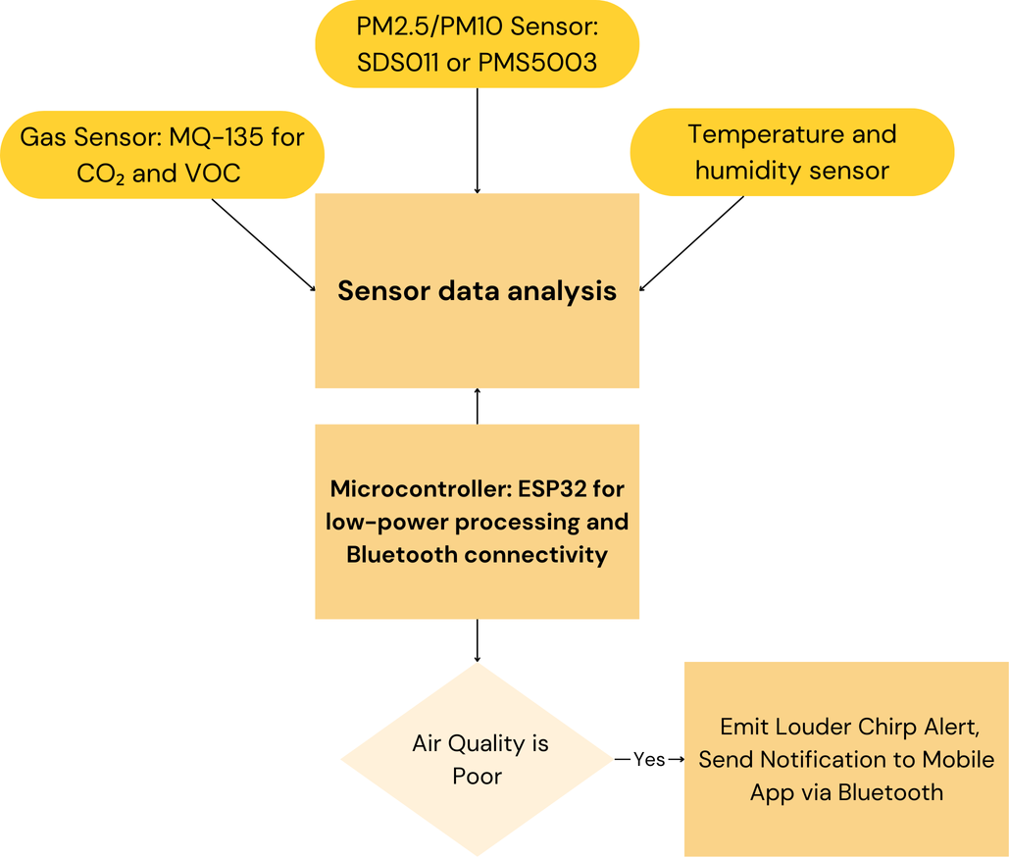
TECHNICAL
APPROACH
01
Sensors
Gas Sensor: MQ-135 for CO₂ and VOC monitoring and MQ-7 for CO emission readings.
BME680 for overall air quality readings.
Microcontroller: ESP32 for low-power processing and Wi-Fi connectivity for seamless connectivity to the web.
Display: OLED for real-time data display.
Speaker: Integrated in the bird’s beak to produce chirps.
Heart Rate Monitor: MAX3010 for checking vitals in case of emergencies.
Panic Button: In case of emergencies just by the click of a button all the readings will be taken and displayed.
02
Fabrication
To design a product that can be versatile, light weight and compact we decided to go with PLA. Its mechanical properties are best suited for cheepa and the overall cost is reduced while not compromising on the build quality.

Slide 5

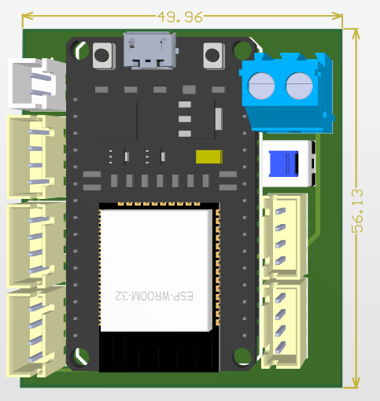
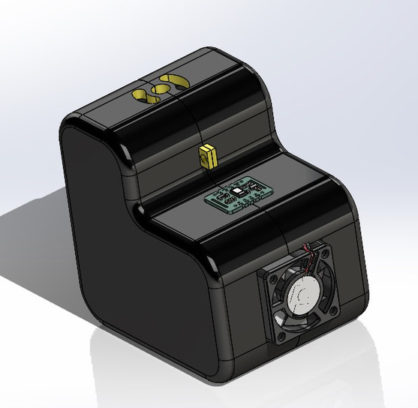
OUR APPROACH
Cheepaa

Slide 6
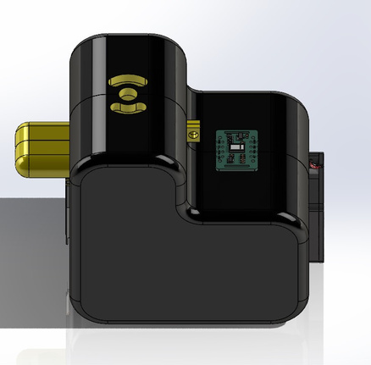
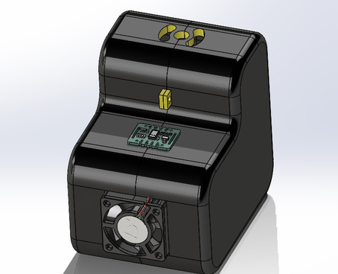
APPLICATIONS
Cheepa
Keychains
Wind chimes
Paper weights
Baby Decor
A compact and portable air quality monitor that users can carry with them everywhere, ensuring constant monitoring of their environment.
Designed to blend into everyday settings; the device can be attached to wind chimes, offering aesthetic appeal along with air quality alerts.
Can double as a functional item on desks while monitoring indoor air quality, ideal for office and home use.
Ideal for monitoring the air quality in spaces where infants sleep or play, helping parents ensure a safe breathing environment for their children.

Slide 7
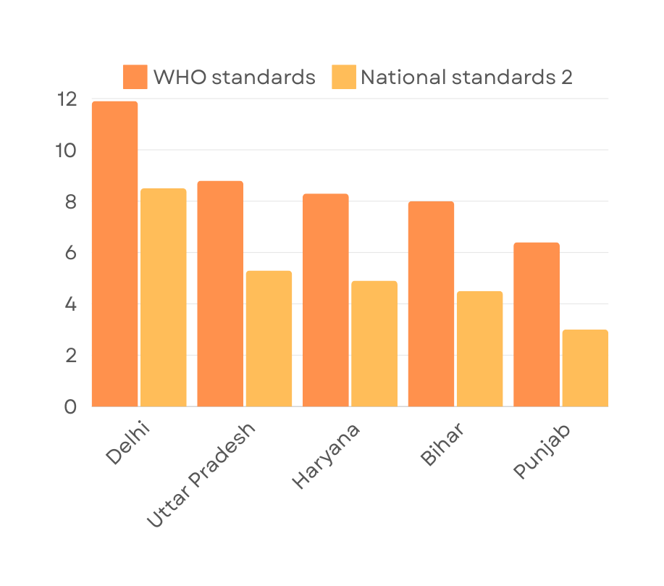
STATISTIC
Cheepaa
Bar Graph showing the effect of AQI Index i.e. Air Pollution on the life expectancy fo the residents. We compare the life expectancy one can gain when the PM2.5 si reduced to WHO standards and National standards

Slide 8




Cheepaa
TIMELINE
Brainstorming and Finalization with Concept of Cheepa
Assembling and Testing
Research and Background on Air Quality Detection
Tech Selection and Coding

Slide 9
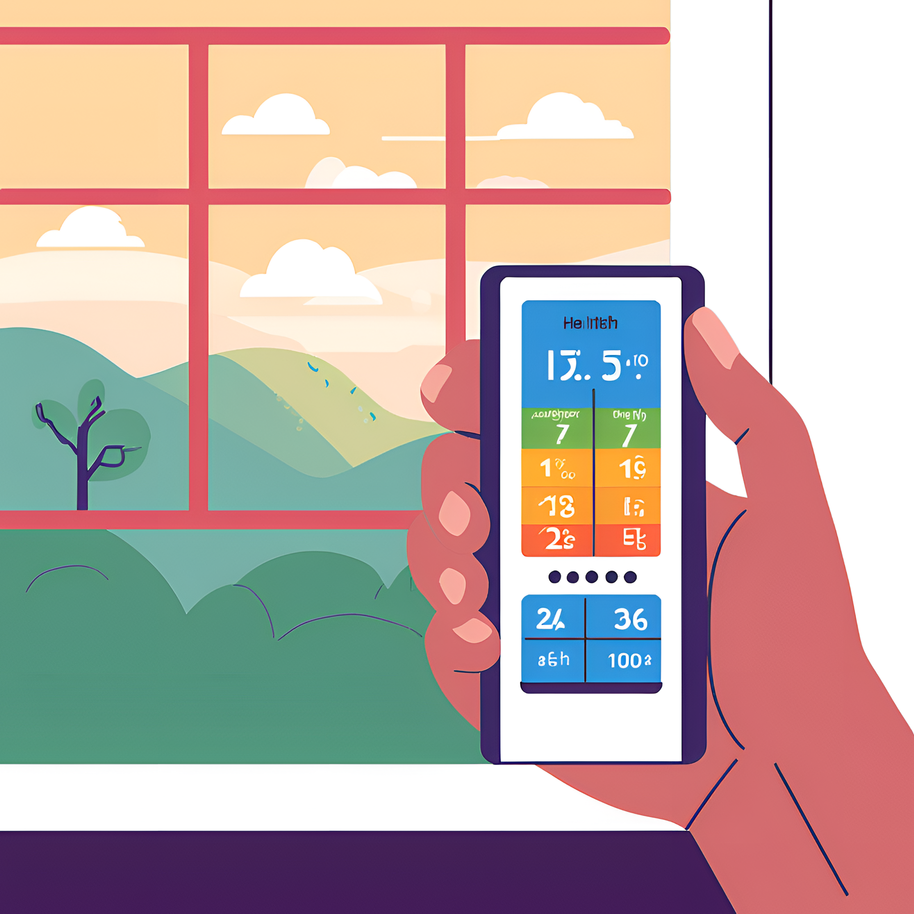


Cheepaa
TEAM
Asutosh Kumar Chouhan
Namit singh
Ayushman Das
Agamjot Kaur Choudhary
Jatin Santosh Naik

